Slide 1
JavaScript
Lecture 3

Slide 2
Working with Data Types (recap)
Strongly typed programming languages
Require declaration of the data types of variables
Strong typing also known as static typing
Data types do not change after declared
Loosely typed programming languages
Do not require declaration of the data types of variables
Loose typing also known as dynamic typing
Data types can change after declared

Slide 3
Strings and Empty Strings
Empty String
Zero length string value
Valid for literal strings
Not considered to be null or undefined
Ex. var customername=“”;
Why would you need to assign an empty string ?

Slide 4
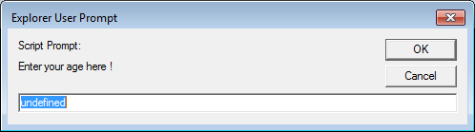
Strings and Empty Strings
Consider the following prompt() method which displays a dialog box with a message, a text box, an OK button, and a Cancel button.
You can pass 2 strings arguments to the prompt method.
The first argument displays an instruction to the user , the second is the default text that appears in the textbox.
If you leave out the second argument, the value “undefined” appears as shown below.
window.prompt("Enter your age here !");
To prevent undefined appearing in the textbox you pass an empty string as the second argument.
window.prompt("Enter your age here !", "");

Slide 5
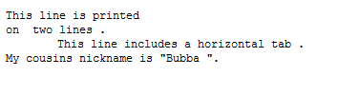
Escaping characters
What would be the line of code to output the following line of text onto the screen.
My JavaScript files are located in C:\Javascript_Projects\Files\
<pre><script type="text/javascript">
/* <![CDATA[ */
document.write("<p> This line is printed \n on two lines .</p>");
document.write("<p> \tThis line includes a horizontal tab . </p>");
document.write("<p> My cousins nickname is \"Bubba \". </p>");
/* ]]> */</pre>

Slide 6
Arithmetic Operators
When attempting to perform arithmetic operations on string values, JavaScript interpreter:
Attempts to convert the string values to numbers
x=“4”;
y=“5”;
arithmeticValue=x*y; //the value 20 is returned
Does not convert strings to numbers when using the addition operator (combined instead of added)
x=“4”;
y=“5”;
arithmeticValue=x+y; //whats the value?????
Also refer to the earlier file numberstostrings.html

Slide 7
Converting Strings to Numbers
JS provides 2 functions to convert strings to numbers: parseInt() and parseFloat()
parseInt()
Accepts a string value and coverts it to a number
var num = parseInt(“45”);
Converts the string “45” to the number 45 and stores it in the num variable.
parseInt() returns a whole number. If a string containing a decimal number is passed, it drops the decimal and the numbers after it and returns the whole number. It does not round up.
num=parseInt(“1.8392”); //returns 1
parseFloat()
Sometimes you will need to retain the decimal numbers. In these cases use the parseFloat().
var floatednum = parseFloat(“1.8392”); //returns 1.8392

Slide 8
This code demonstrates how parseInt() and parseFloat() parse strings that contain alphabetical characters.
var num = parseInt(“45abc”); //45
var num = parseFloat(“45.56abc”); //45.56
var num = parseInt(“45abc123”); //45

Slide 9
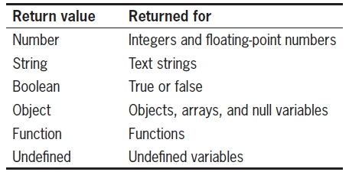
Special Operators
typeof(variableName);
You should use this operator whenever you need to be sure that a variable is the correct data type.
Values returned by typeof operator

Slide 10
Working with Functions
Methods
Procedures associated with an object
Functions
Related group of JavaScript statements
Executed as a single unit
Virtually identical to methods
Not associated with an object
Must be contained within a <script> element

Slide 11
Defining Functions
Function definition
Lines making up a function
Syntax
function nameOfFunction(parameters) {
statements;
}
Parameter
Variable used within a function
Placed within parentheses following a function name
function calculate_square_root(number1) {
statements;
}
Multiple parameters allowed
calculate_square_root(number1, number2, number3)

Slide 12
Defining Functions (cont’d.)
Function statements
Do the actual work
Contained within function braces
Put functions within the document head
Place the “calls” to a function within the body section
function printStudentNames(student1, student2, student3) {
document.write("<p>" + student1 + "</p>");
document.write("<p>" + student2 + "</p>");
document.write("<p>" + student3 + "</p>");
}

Slide 13
Calling Functions
To execute a function:
Must invoke, or call it
Function call
Code calling a function
Consists of function name followed by parentheses
Contains any variables or values to be assigned to the function parameters
Arguments (actual parameters)
Variables (values) placed in the function call statement parentheses
...onclick=“printStudentNames(Anne, Joe, Mary)”

Slide 14
Calling Functions (cont’d.)
Passing arguments
Sending arguments to parameters of a called function
Argument value assigned to the corresponding parameter value in the function definition
Can return function value to a calling statement
Return statement
Returns a value to the statement calling the function
Use the return keyword with the variable or value you want to send to the calling statement

Slide 15
Calling Functions (cont’d.)
Example:
function averageNumbers(a, b, c) {
var sum_of_numbers = a + b + c;
var result = sum_of_numbers / 3;
return result;
}
Somewhere in the body…
var returnValue = averageNumbers(1,2,3);

Slide 16
Understanding Variable Scope
Variable scope
Where in a program a declared variable can be used
Global variable
Declared outside a function
Available to all parts of a program
Keyword var optional
Local variable
Declared inside a function
Only available within the function in which it is declared
Cease to exist when the function ends
Keyword var required

Slide 17
Understanding Variable Scope (cont’d.)
Good programming technique
Always use the var keyword when declaring variables
Clarifies where and when variable used
Poor programming technique
Declaring a global variable inside of a function by not using the var keyword
Harder to identify global variables in your scripts

Slide 18
<script type="text/javascript">
var salesPrice=100.00;
function applyShipping() {
shippingPrice=8.95;
var totalPrice=salesPrice+shippingPrice;
document.write("<p> The sales price is" + salesPrice + "<br />");
document.write(" The shipping price is" + shippingPrice + "<br />");
document.write("The sales price plus shipping is" + totalPrice + "<br /></p>");
}
</script></head><body>
<script type="text/javascript">
applyShipping();
document.write("<p> The sales price is" + salesPrice + "<br />");
document.write(" The shipping price is" + shippingPrice + "<br />");
document.write("The sales price plus shipping is" + totalPrice + "<br /></p>");
document.write(" The shipping price is" + shippingPrice + "<br />");
</script></body></html>

Slide 19
Understanding Variable Scope (cont’d.)
Program may contain global and local variables with the same name
Local variable takes precedence when its function is called
However the value assigned to local variable of the same name is not assigned to global variable of the same name

Slide 20
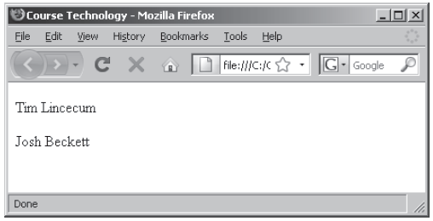
Understanding Variable Scope (cont’d.)
var pitcher = "Josh Beckett";
function duplicateVariableNames() {
var pitcher = "Tim Lincecum";
document.write("<p>" + pitcher + "</p>");
// value printed is Tim Lincecum
}
duplicateVariableNames();
document.write("<p>" + pitcher + "</p>");
// value printed is Josh Beckett

Slide 21
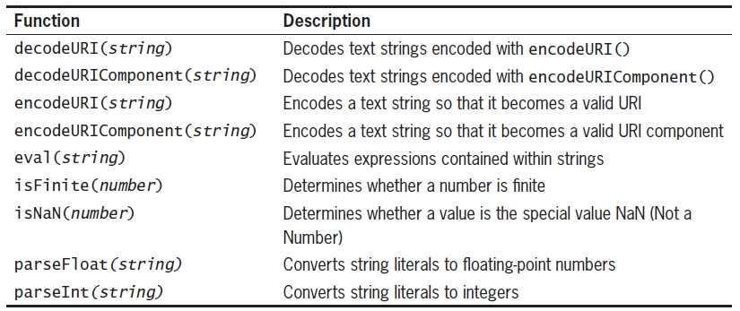
Using Built-in JavaScript Functions
Called the same way a custom function is called
Built-in JavaScript functions

Slide 22
We will look at these functions as we go through the course but for now all you need to understand is that you call a built in function in the same way you call a custom function.
var socialSecurityNumber = “123-45-6789”;
var checkVar = isNaN(socialSecurityNumber);
document.write(checkVar);

